Slide 1

Palmer penguins Classification
By
Hirad Yazdankhah
Aug 4, 2022
All Artworks by Artwork by @allison_horst
https://allisonhorst.github.io/palmerpenguins/articles/art.html

Slide 2
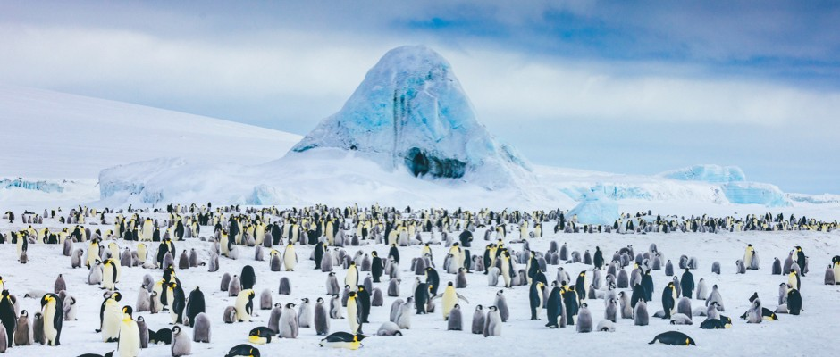
Problem Statement
Stakeholders
Scientists
Problem Statement
Scientists are interested in identifying /classifying the penguins on 3 islands of (Biscoe, Dream, Torgersen) in Antarctica, so they can learn more about their behavior ,evolution and resilience to environmental conditions including food resources and melting ice conditions.

Slide 3
Dataset
Dataset:
Palmer Archipelago (Antarctica) penguin data
Acknowledgements :
Data were collected and made available by Dr. Kristen Gorman and the Palmer Station, Antarctica LTER, a member of the Long Term Ecological Research Network.
Link:
https://www.kaggle.com/datasets/parulpandey/palmer-archipelago-antarctica-penguin-data

Slide 4
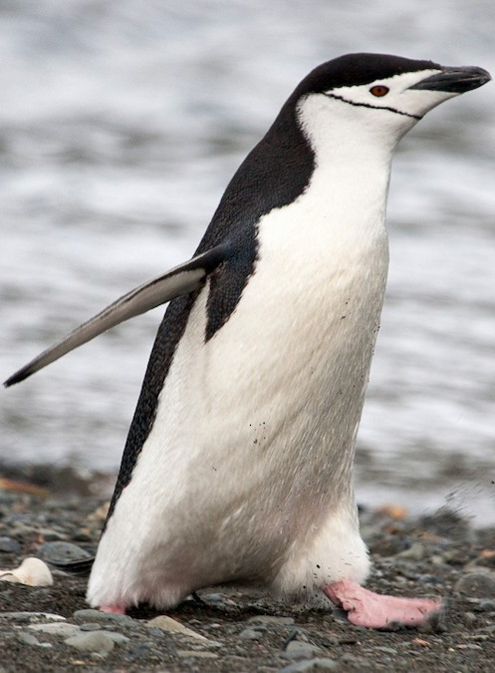
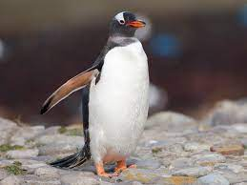
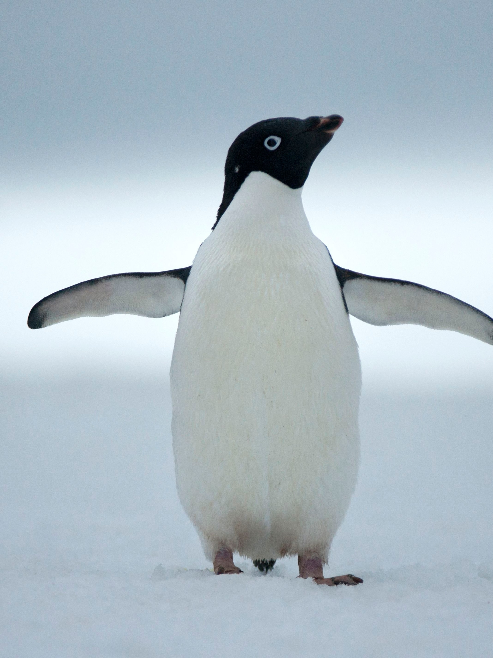
Penguins Types & Features
CHINSTRAP
GENTOO
ADELIE
https://ebird.org/species/chipen2
https://ebird.org/species/genpen1
https://www.nationalgeographic.com/animals/birds/facts/adelie-penguin

Slide 5
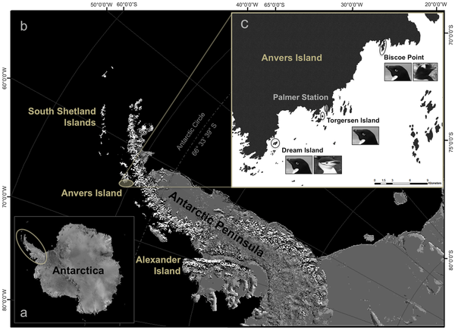
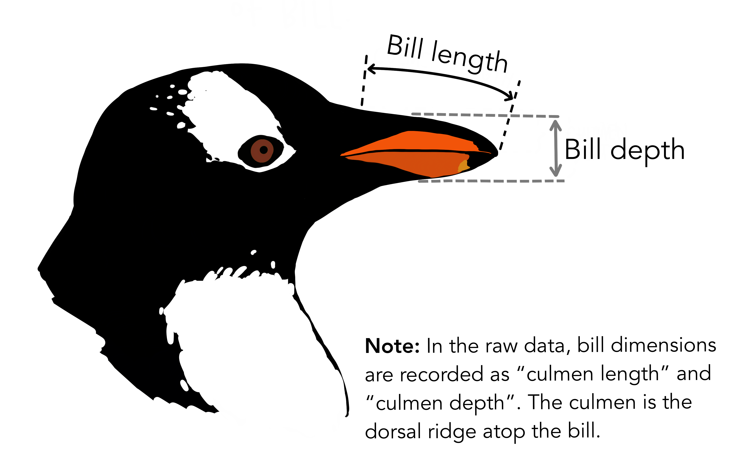
Palmer Penguin Database Features:
344 Penguin Data Points collected
Including the following features:
Island
Culmen Length mm
Culmen depth mm
Flipper length
Body Mass
Sex

Slide 6
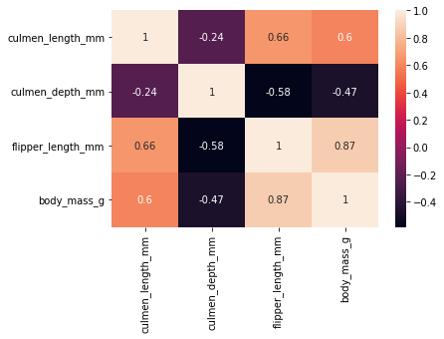
Significant correlation between penguin flipper length and Body mass

Slide 7
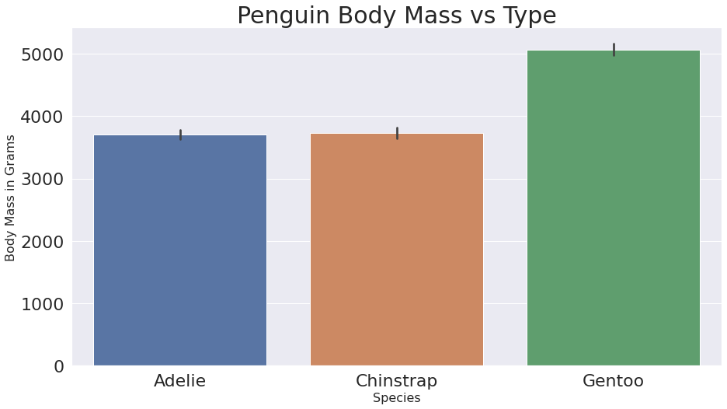
The Gentoo species can be differentiated from the Adelie and Chinstrap species depending on the culmen length

Slide 8
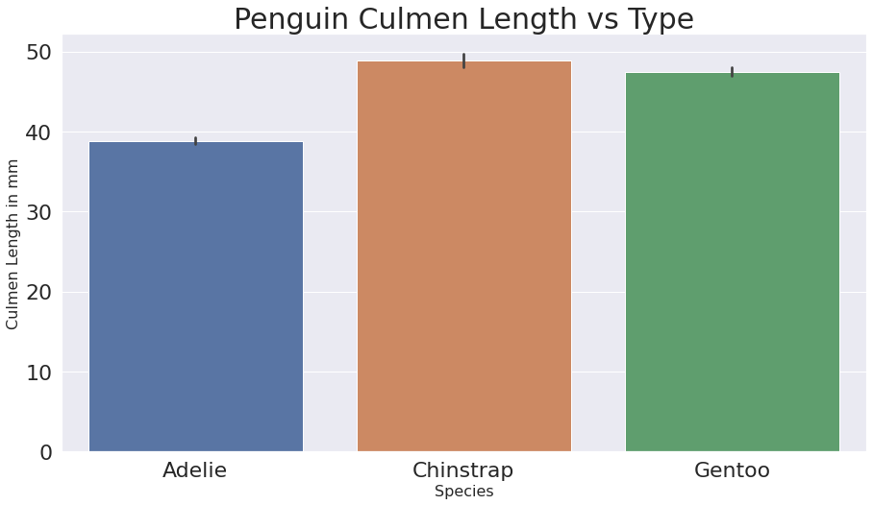
The Adelie species can be differentiated from the Gentoo and Chinstrap species depending on the culmen length

Slide 9
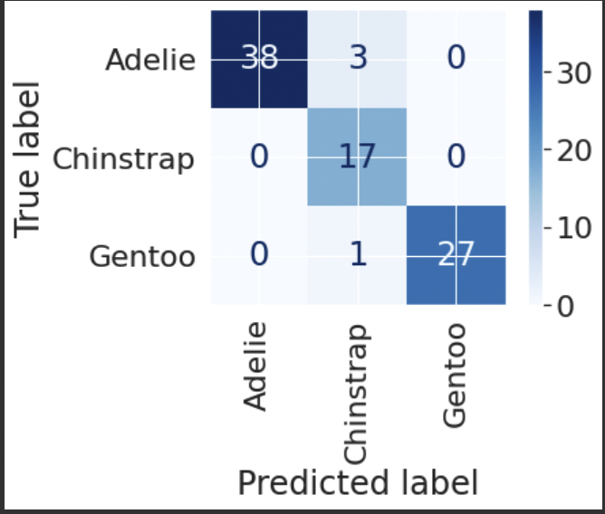
KNN Model & Metrics
We started with data on 344 Penguins:
Adelie 152
Gentoo 124
Chinstrap 68
We split our data into Training and Test sets.
We trained on 258 data points and tested the model on 86 Data points.
Note: 37+17+27+1+1+3=86

Slide 10
THE END

Slide 11
BACKUP SLIDES

Slide 12
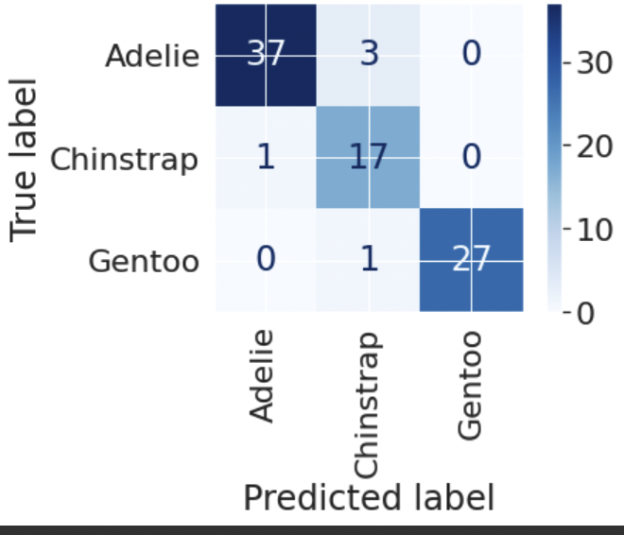
Decision Tree Model Metrics
Test Accuracy:0.942
precision recall f1-score support
Adelie 0.97 0.93 0.95 40
Chinstrap 0.81 0.94 0.87 18
Gentoo 1.00 0.96 0.98 28
accuracy 0.94 86
macro avg 0.93 0.94 0.93 86
weighted avg 0.95 0.94 0.94 86

Slide 13
Backup-KNN Model no PCA Metrics
Classification Accuracy No PCA: 0.988
precision recall f1-score support
Adelie 0.97 0.93 0.95 40
Chinstrap 0.81 0.94 0.87 18
Gentoo 1.00 0.96 0.98 28
accuracy 0.94 86
macro avg 0.93 0.94 0.93 86
weighted avg 0.95 0.94 0.94 86

Slide 14
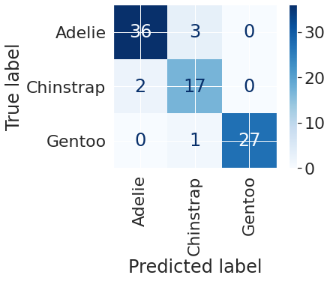
Backup-KNN Model with PCA Metrics
Classification Accuracy With PCA: 0.988
precision recall f1-score support
Adelie 0.97 0.93 0.95 40
Chinstrap 0.81 0.94 0.87 18
Gentoo 1.00 0.96 0.98 28
accuracy 0.94 86
macro avg 0.93 0.94 0.93 86
weighted avg 0.95 0.94 0.94 86

